Slide 1
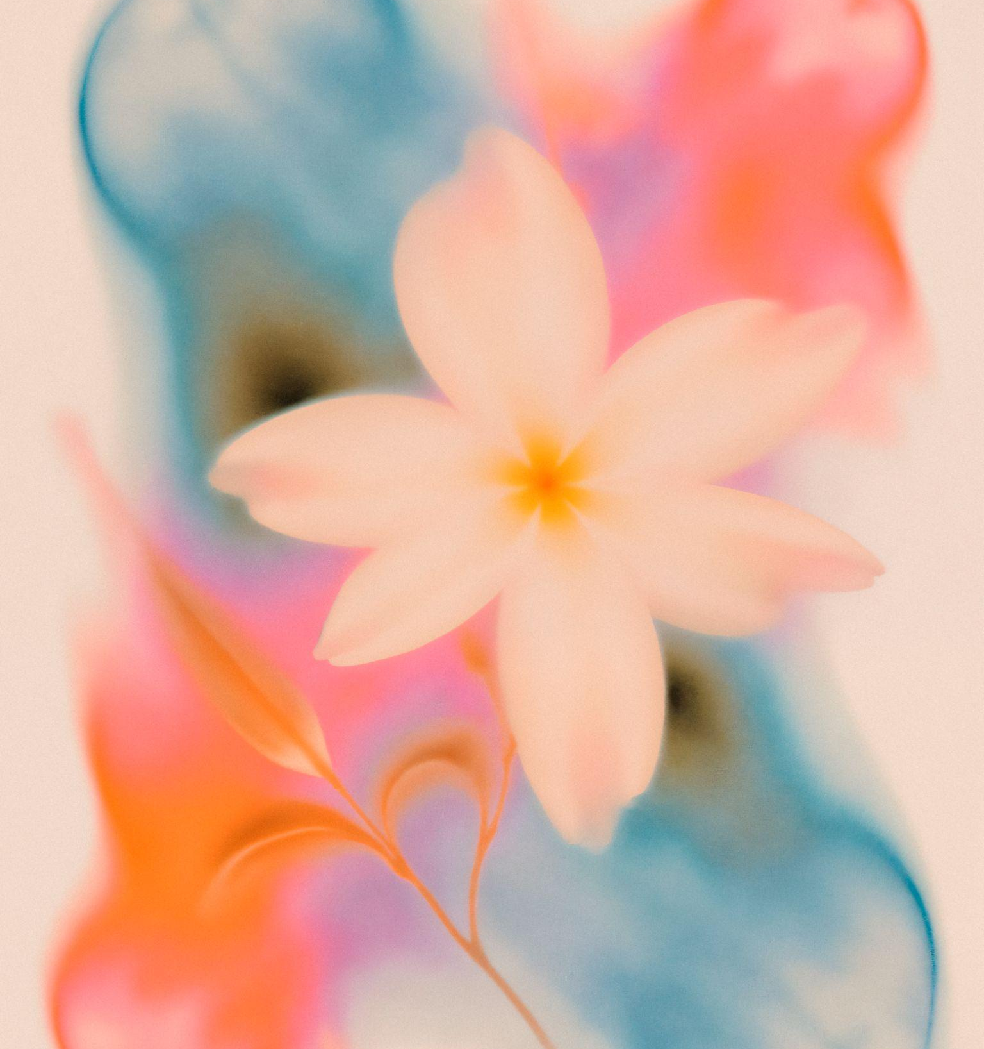
CREATIVE WATERCOLOR
Here is where your presentation begins
DESIGNED FOR YOU

Slide 2

CONTENTS OF THIS TEMPLATE
Fonts
Colors
Thanks slide
Icons and infographics
To view this template correctly in PowerPoint, download and install the fonts we used
You can see on the link all the colors used in this presentation
You must keep it so that proper credits for our design are given
These can be used in the template, and their size and color can be edited
For more info:
SLIDESGO | SLIDESGO AI TOOLS | BLOG | FAQs
You can edit the master slides easily. For more info, click here
You can visit our sister projects:
FREEPIK AI TOOLS | FREEPIK LIBRARY RESOURCES
You can delete this slide when you’re done editing the presentation

Slide 3
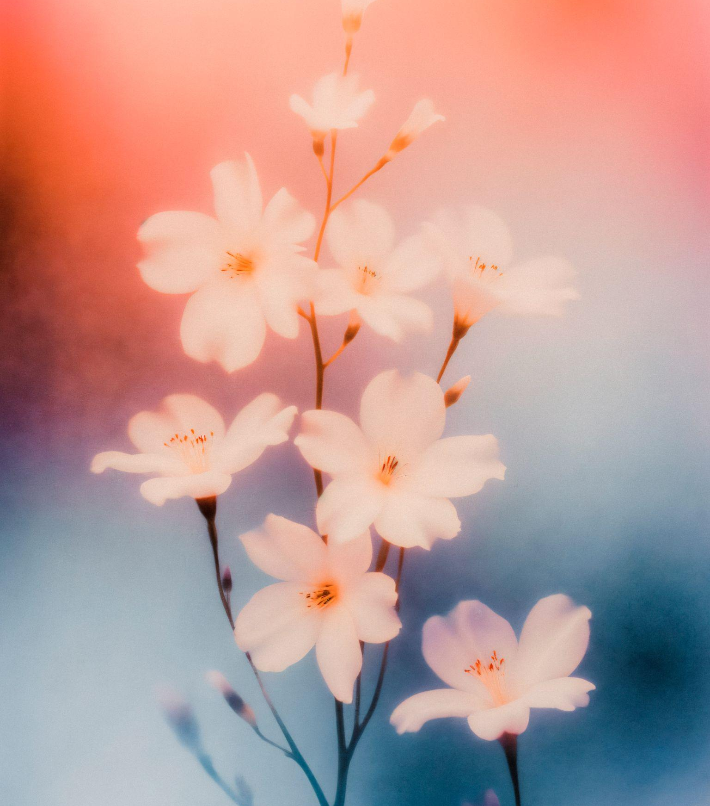
01
02
03
04
05
06
TABLE OF CONTENTS
07
08
NAME OF THE SECTION
NAME OF THE SECTION
NAME OF THE SECTION
NAME OF THE SECTION
NAME OF THE SECTION
NAME OF THE SECTION
NAME OF THE SECTION
NAME OF THE SECTION

Slide 4
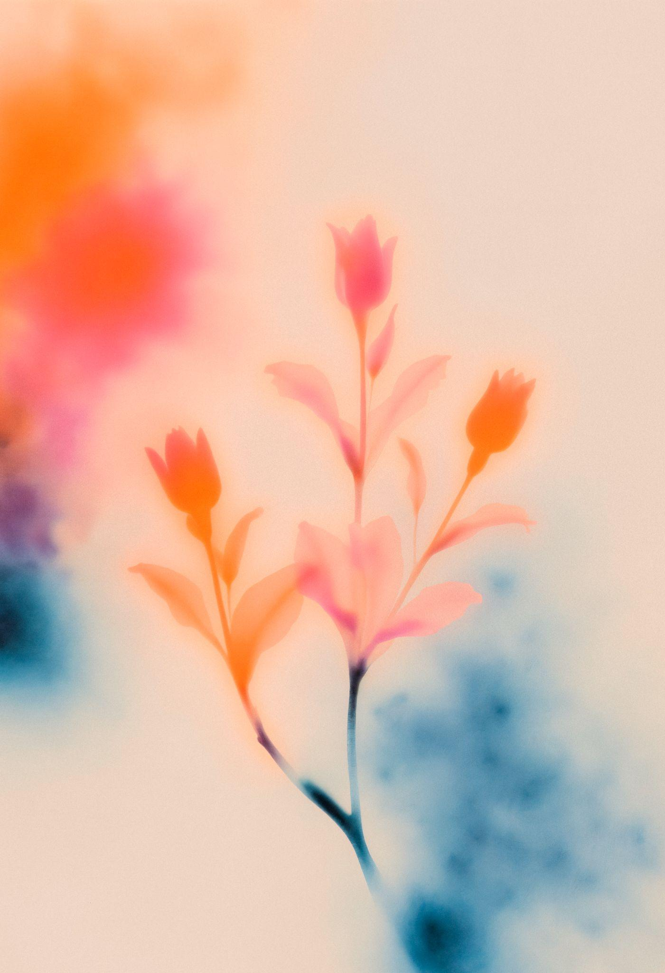
YOU CAN WRITE HERE A LONG TITLE TO CAPTIVATE THE AUDIENCE ATTENTION
Do you know what helps you make your point clear?
Lists like this one:
They’re simple
You can organize your ideas clearly
You’ll never forget to buy milk!
You can replace the image. Just right-click on it and select “Replace image”

Slide 5
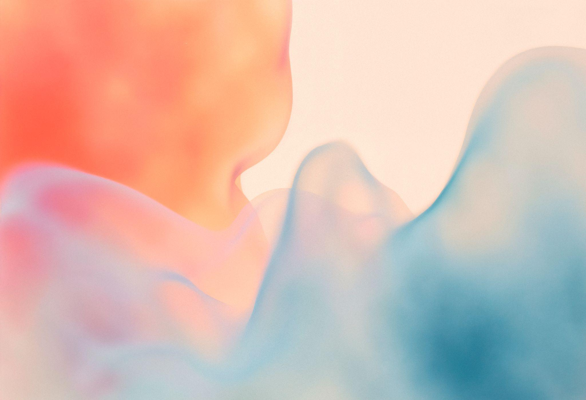
01
NAME OF THE SECTION
You can enter a subtitle here if you need it

Slide 6
LET’S HAVE A LOOK
Mercury is the closest planet to the Sun and the smallest one in the entire Solar System. This planet’s name has nothing to do with the liquid metal, since Mercury was named after the Roman messenger god. Despite being closer to the Sun than Venus, its temperatures aren't as terribly hot as that planet’s. Its surface is quite similar to that of Earth’s Moon, which means there are a lot of craters and plains. Speaking of craters, many of them were named after artists or authors who made significant contributions to their respective fields. Mercury takes a little more than 58 days to complete its rotation, so try to imagine how long days must be there!

Slide 7
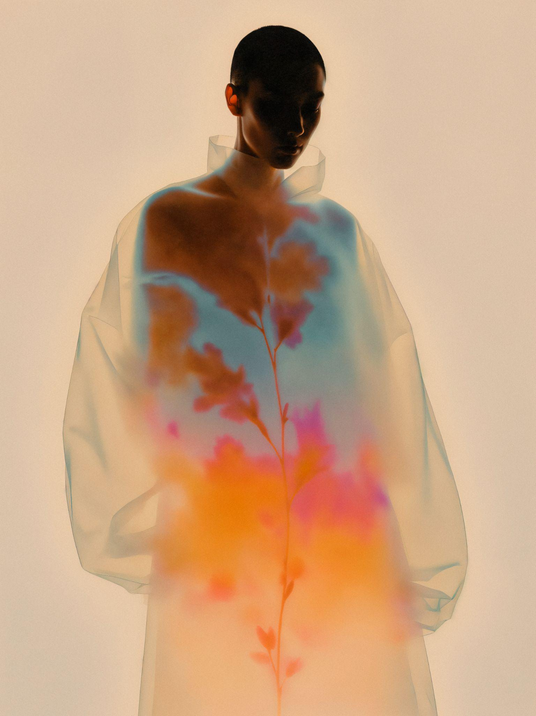
TWO IDEAS
LET’S LEARN ABOUT MERCURY
Mercury is the closest planet to the Sun and the smallest one in the Solar System. This planet’s name has nothing to do with the liquid metal
LET’S TAKE A LOOK AT VENUS
Venus has a beautiful name and is the second planet from the Sun. It’s hot and is the second-brightest natural object in the night sky

Slide 8
THREE IDEAS
THIS IS ABOUT MERCURY
Mercury is the closest planet to the Sun and the smallest one in the Solar System. This planet’s name has nothing to do with the liquid metal
WHAT DO WE KNOW ABOUT VENUS?
Venus has a beautiful name and is the second planet from the Sun. It’s terribly hot, even hotter than Mercury, and its atmosphere is extremely poisonous
SOME THINGS ABOUT PLANET JUPITER
Jupiter is a gas giant and the biggest planet in the Solar System. It’s the fourth-brightest object in the night sky. It was named after the Roman god of the skies and lightning

Slide 9
SIX IDEAS
01
04
02
05
03
06
Mercury is the smallest planet in the Solar System, even smaller than some of the moons of other planets
Jupiter, the largest planet in the Solar System, is a gas giant. It ranks as the fourth-brightest object in the night sky
Despite its red appearance, Mars is actually a cold planet. The surface is covered in iron oxide dust
Saturn is primarily composed of hydrogen and helium, making it a massive gas giant
Venus has a beautiful name and is the second planet from the Sun. Its atmosphere is extremely poisonous
Neptune is the farthest planet from the Sun in our Solar System. It’s known for its deep blue color

Slide 10
A PICTURE IS WORTH A THOUSAND WORDS

Slide 11
OUR HISTORY
01
02
03
04
THIS IS VENUS
THIS IS SATURN
THIS IS MARS
THIS IS NEPTUNE
Venus is the second planet from the Sun
Saturn is composed of hydrogen and helium
Despite being red, Mars is actually a cold place
Neptune is the farthest planet from the Sun

Slide 12
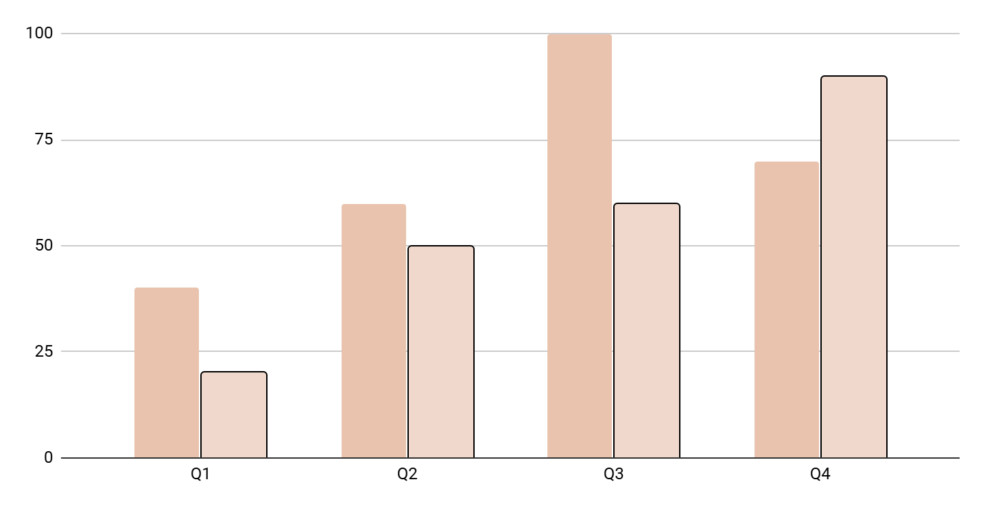
REPRESENT YOUR DATA HERE
YEAR | VENUS | MARS
20xx | $0.30 | $31.90
20xx | $3.90 | $15.40
20xx | $157.30 | $492.80
20xx | $3,368.20 | $13,929.80
THIS IS MARS
THIS IS NEPTUNE
Despite being red, Mars is actually a really cold place
Neptune is the farthest planet from the Sun
Follow the link in the graph to modify its data and then paste the new one here. For more info, click here

Slide 13
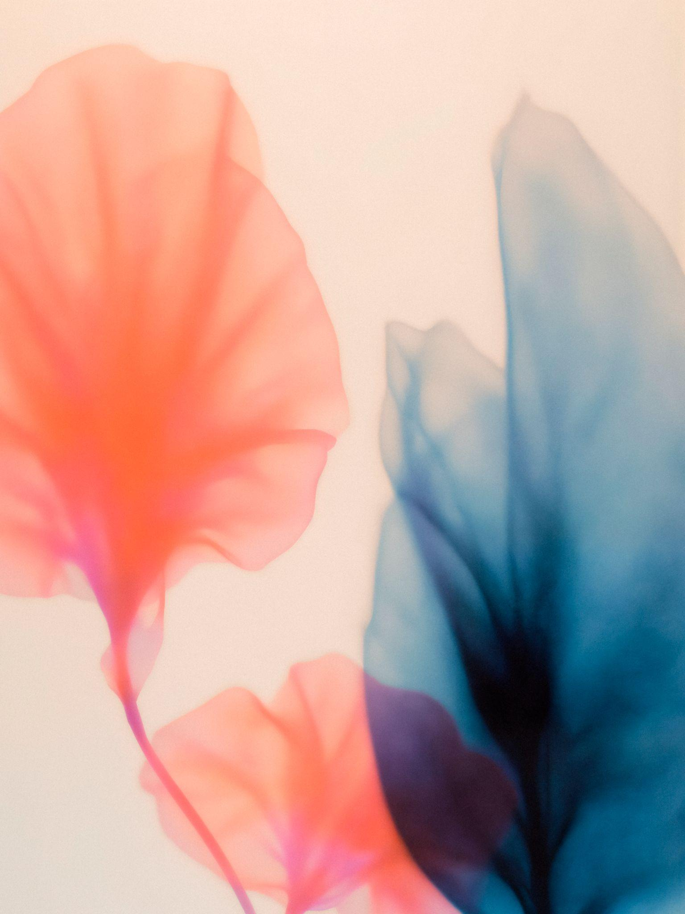
333,000
386,000 km
The Sun’s mass compared to Earth’s
Distance between Earth and the Moon

Slide 14
THANK YOU
Do you have any questions?
youremail@freepik.com
+00 000 000 000
yourwebsite.com
Please keep this slide for attribution

